Slide 1
Neural networks
Edited by
Matteo Bertoia

Slide 2
Contents
1. Software needs
2. NN architecture
3. Coding
4. Testing

Slide 3
Software needs
Anaconda3:
useful platform for data science, big data, machine learning;
it allows an easy and user friendly (through GUI) installation for libraries/modules (ex. PyTorch, Numpy…);
Python 3.9.13:
- high level language with many good libraries for data science
Jupyter lab:
useful code editor for data science; it is a good candidate to implement NNs

Slide 4
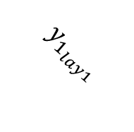
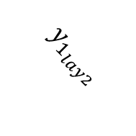
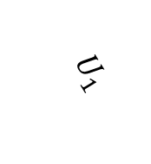
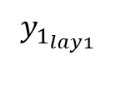
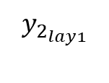
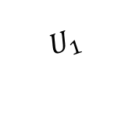

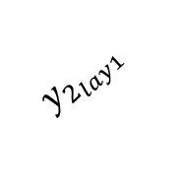
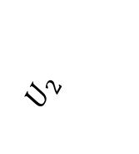
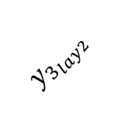
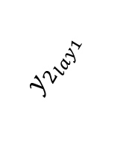

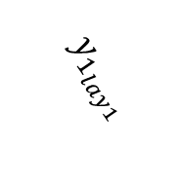
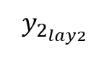
NN architecture (example feed-forward case)
HIDDEN LAYERS
1
$y_{1_{lay1}}$
INPUT LAYER
$$U_{1}$$
1
1
$y_{1_{lay1}}$
$y_{1_{lay2}}$
$y_{1_{lay1}}$
OUTPUT LAYER
$$U_{1}$$
$$y_{2_{lay2}}$$
2
$$Y_ol$$
1
$U_{2}$
$$y_{2_{lay1}}$$
$$y_{2_{lay1}}$$
$$y_{3_{lay2}}$$
$$y_{2_{lay1}}$$
2
$$U_{2}$$
3
2

Slide 5
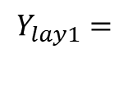



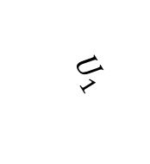





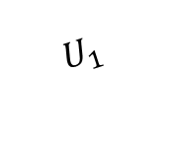
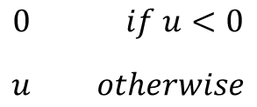





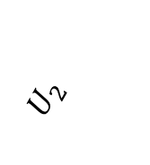



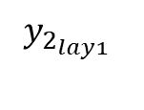


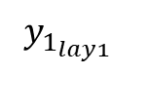



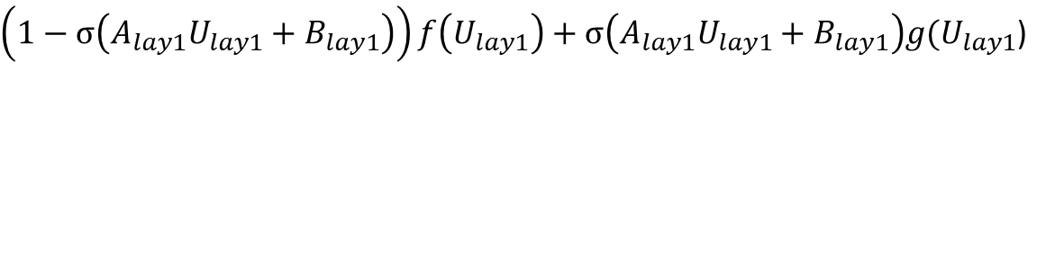
The output from the first hidden layer =>
$$Y_{lay1}=$$
$\left(1−σ\left(A_{lay1}U_{lay1}+B_{lay1}\right)\right)f\left(U_{lay1}\right)+σ\left(A_{lay1}U_{lay1}+B_{lay1}\right)g(U_{lay1}$)
FIRST HIDDEN
LAYER
$$where:$$
$$[$$
$$]$$
$y_{1_{lay1}}$
$$w_{{11}_{lay1}} w_{{12}_{lay1}}$$
$w_{{21}_{lay1}} w_{{22}_{lay1}}$
1
$$A_{lay1}\left(weight\right)=$$
INPUT LAYER
$$U_{1}$$
$$[$$
$$]$$
$$b_{1_{lay1}}$$
$$b_{2_{lay1}}$$
1
$$B_{lay1}\left(bias\right)=$$
$$[$$
$$]$$
$$U_{1}$$
$$y_{1_{lay1}}$$
$$y_{2_{lay1}}$$
$$Y_{lay1}\left(output\right)=$$
$U_{2}$
$$[$$
$$]$$
$$U_{lay1}\left(input\right)=$$
$$U_{1}$$
$$U_{2}$$
$$\{$$
$$0 if u<0$$
$$u otherwise$$
$$σ\left(u\right)=$$
2
$$U_{2}$$
$y_{2_{lay1}}$
2
$$f and g are smooth functions$$

Slide 6


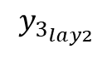

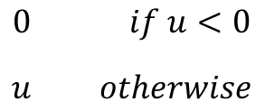






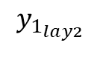
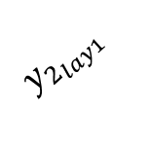






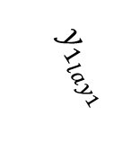



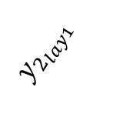



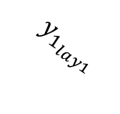
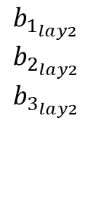

The output from the second hidden layer =>
$$Y_{lay2}=\left(1−σ\left(A_{lay2}U_{lay2}+B_{lay2}\right)\right)f\left(U_{lay2}\right)+σ\left(A_{lay2}U_{lay2}+B_{lay2}\right)g(U_{lay2})$$
$$where:$$
$$[$$
$$]$$
FIRST HIDDEN
LAYER
SECOND HIDDEN
LAYER
$${ w}_{{11}_{lay2}} w_{{12}_{lay2}}$$
${ w}_{{21}_{lay2}} w_{{22}_{lay2}}$
$${ w}_{{31}_{lay2}} w_{{32}_{lay2}}$$
$$A_{lay2}(weight)=$$
1
$$y_{1_{lay1}}$$
$$y_{1_{lay2}}$$
$$[$$
$$]$$
1
$b_{1_{lay2}}$
$b_{2_{lay2}}$
$b_{3_{lay2}}$
$$y_{1_{lay1}}$$
$$B_{lay2}\left(bias\right)=$$
$$y_{1_{lay1}}$$
$$[$$
$$]$$
$$y_{1_{lay2}}$$
$$y_{2_{lay2}}$$
$$y_{3_{lay2}}$$
$$y_{2_{lay2}}$$
2
$$Y_{lay2}\left(output\right)=$$
$$[$$
$$]$$
$$y_{2_{lay1}}$$
$$y_{2_{lay1}}$$
$$y_{1_{lay1}}$$
$$y_{2_{lay1}}$$
$$U_{lay2}\left(input\right)=$$
$$\{$$
$$y_{2_{lay1}}$$
$$y_{3_{lay2}}$$
$$0 if u<0$$
$$u otherwise$$
3
$$σ\left(u\right)=$$
2
$$f and g are smooth functions$$

Slide 7


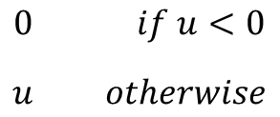


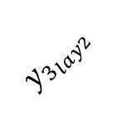


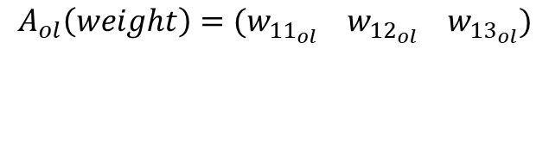


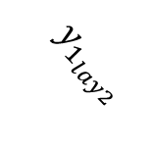




The output from the output layer =>
$$Y_{ol}=\left(1−σ\left(A_{ol}U_{ol}+B_{ol}\right)\right)f\left(U_{ol}\right)+σ\left(A_{ol}U_{ol}+B_{ol}\right)g(U_{ol})$$
SECOND HIDDEN
LAYER
$$where:$$
$$A_{ol}\left(weight\right)=(w_{{11}_{ol}} w_{{12}_{ol}} w_{{13}_{ol}})$$
1
$$Y_{ol}\left(output\right)=y_ol$$
$$y_{1_{lay2}}$$
$$B_{ol}(bias)=b_ol$$
$$[$$
$$]$$
OUTPUT LAYER
$$y_{1_{lay2}}$$
$$y_{2_{lay2}}$$
$$y_{3_{lay2}}$$
$U_{ol}\left(input\right)=$
$$y_{2_{lay2}}$$
$$Y_ol$$
2
1
$$\{$$
$$y_{3_{lay2}}$$
$$0 if u<0$$
$$u otherwise$$
$$σ\left(u\right)=$$
3
$$f and g are smooth functions$$

Slide 8
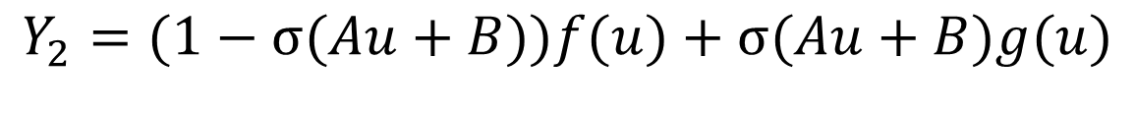
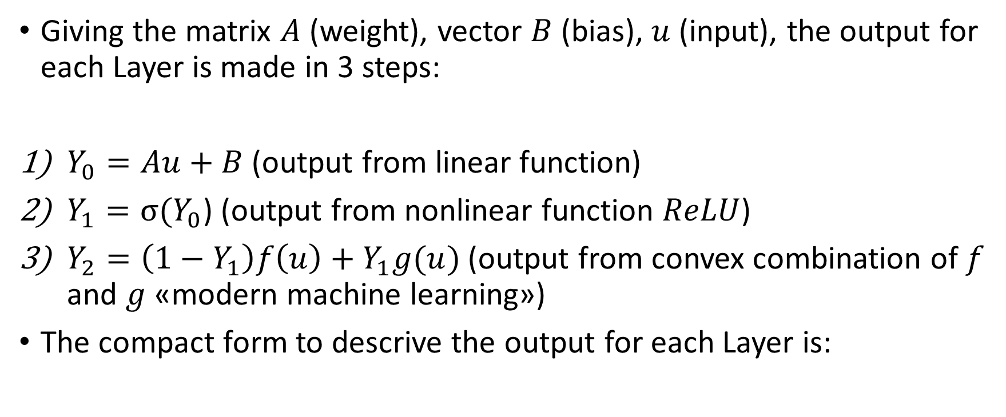
Clarifications
Giving the matrix $A$ (weight), vector $B$ (bias), $u$ (input), the output for each Layer is made in 3 steps:
$Y_{0}=Au+B$(output from linear function)
$Y_{1}=σ(Y_{0}$) (output from nonlinear function $ReLU$)
$Y_{2}=\left(1−Y_{1}\right)f\left(u\right)+Y_{1}g(u)$(output from convex combination of $f$ and $g$ «modern machine learning»)
The compact form to descrive the output for each Layer is:
$$Y_{2}=(1−σ(Au+B))f(u)+σ(Au+B)g(u)$$

Slide 9
Coding
PROJECT FILES:
main.py
layer_linear_fun.py
layer_ReLU_fun.py
layer_convex_comb_fun.py
trainingNN_fun.py
layer_class.py

Slide 10
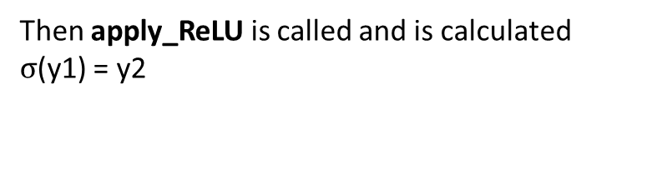
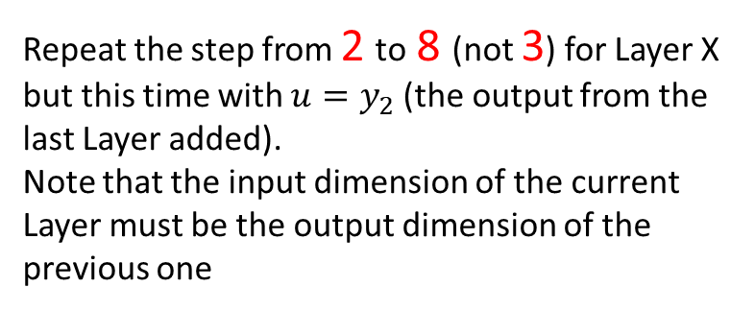
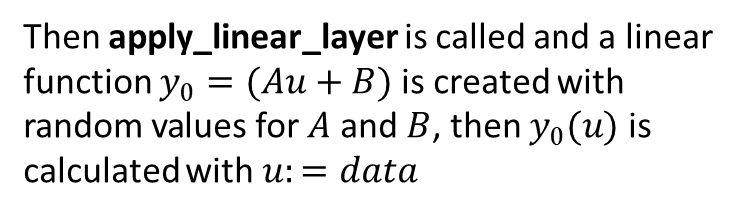
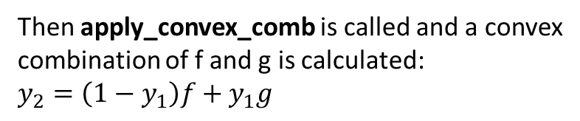
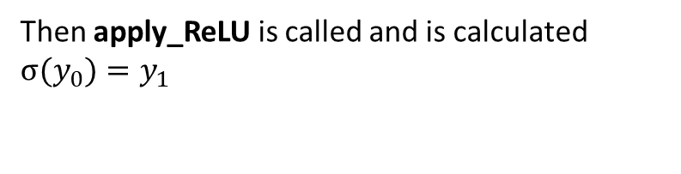

Create the NN
1
Run main.py
Then apply_convex_comb is called and a convex
combination of f and g is calculated:
$y_{2}=\left(1−y_{1}\right)f+y_{1}g$
6
2
The User set (from standard input) the
dimension of the input/output for Layer 0
Then all the information about Layer 1 are printed
to standard output such as $A, B, y_{0}, y_{1}, y_{2}$
7
3
A tensor of random values (var «data») is
created as an input for Layer 0
The NN is saved into array (var
«layer_list»);
each element is an object of the Layer class
Ask the User if wants to add a new Layer (it would
be Layer 1). If yes, proceed to 9
NO
9b
Then apply_linear_layer is called and a linear
function $y_{0}=(Au+B)$is created with
random values for $A$ and $B$, then $y_{0}(u)$is
calculated with $u:=data$
8
4
YES
Repeat the step from 2 to 8 (not 3) for Layer X but this time with $u=y_{2}$(the output from the
last Layer added).
Note that the input dimension of the current Layer must be the output dimension of the previous one
9a
Then apply_ReLU is called and is calculated $σ(y_{0})=y_{1}$
5
Then apply_ReLU is called and is calculated
$σ$(y1) = y2

Slide 11


Training of the NN
1
Run TrainingNN (layer_list)
2
Set input and output data (measurements) of the NN
3
Ask User if wants to tune $A$ e $B$ by considering
$y_{0}$ (or $y_{1}$ or $y_{2}$) for each Layer
Run the training algorithm to find
a good approximation for $A$ and $B$ with k steps.
For each step:
Calculate the output of the NN (seeing NN
as a black box)
Calculate the error between the output of
the NN and the measurements (MSE)
Calculate the partial derivatives with respect
the components of $A_{ij}$ and $B_{ij}$ (for each Layer)
Update $A$ and $B$ (for each Layer)
Print the error every 500 steps to have an idea
about the performances
4

Slide 12



Clarification
If the NN is what shown in slide 3, the $y_{nn}$ (output of the NN) is
calculated as follows:
1) First Initialize y_nn:
$$y_{nn}=U$$
2) For i in range(0, num_layer)
$$Y_{0}=A_{i} y_{nn}+B_{i}$$
$$Y_{1}=ReLU (Y_{0})$$
$${ y}_{nn}=\left(1−Y_{1}\right)f\left(y_{nn}\right)+Y_{1}g\left(y_{nn}\right)$$

Slide 13




To calculate the error use MSE (Mean Square Error):
$$Loss^{\left(n\right)}\left(A_{i,j},B_{i,j}\right)=\sum_{k=1}^{M}{\frac{{\left(ynn_{k}^{\left(n\right)}−ytarget_{k}\right)}^{2}}{N}}$$
Then update the matrixes:
$$A_{i,j}\left(n+1\right)=A_{i,j}\left(n\right)−l_{r}\frac{∂Loss^{\left(n\right)}\left(A_{i,j},B_{i,j}\right)}{∂A_{i,j}}$$
$$B_{i,j}\left(n+1\right)=B_{i,j}\left(n\right)−l_{r}\frac{∂Loss^{\left(n\right)}\left(A_{i,j},B_{i,j}\right)}{∂B_{i,j}}$$
$$l_{r}≔learning rate$$

Slide 14


Testing
Test 1
Description:
U is a 1000 x 3 random matrix containing numbers from 0 to 10, so there are 1000 random sources (rows), each one with dimension 3 (columns).
I create 2 Layers; the first one has 3 input and 4 output, the second one has 4 input and 3 output.
The training was done with 20000 iterations and $l_{r} =$1e-5
The measurements from the system are ${(y_{nn})}_{ij} =$ $e^{u_{ij}}$
I consider first $Y_{0}$and then $Y_{1}$ as the output for each Layer in the NN
Results:
See Test1aLog.txt (output $Y_{0}$) and Test1bLog.txt (output $Y_{1}$)

Slide 15


Test 2
Description:
U is a 1000 x 3 random matrix containing numbers from 0 to 10, so there are 1000 random sources (rows), each one with dimension 3 (columns).
I create 2 Layers; the first one has 3 input and 4 output, the second one has 4 input and 3 output.
The training was done with 20000 iterations and $l_{r} =$1e-5
The measurements from the system are ${(y_{nn})}_{ij} =sin⁡(u_{ij})$
I consider first $Y_{0}$and then $Y_{1}$ as the output for each Layer in the NN
Results:
See Test2aLog.txt (output $Y_{0}$) and Test2bLog.txt (output $Y_{1}$)

Slide 16


Test 3
Description:
U is a 1000 x 3 random matrix containing numbers from 0 to 10, so there are 1000 random sources (rows), each one with dimension 3 (columns).
I create 2 Layers; the first one has 3 input and 4 output, the second one has 4 input and 3 output.
The training was done with 20000 iterations and $l_{r} =$1e-5
The measurements from the system are ${(y}_{nn}){}_{ij}^{ } ={\sum_{k=0}^{j}{(u_{ik})}}_{ }$
I consider first $Y_{0}$and then $Y_{1}$ as the output for each Layer in the NN
Results:
See Test3aLog.txt (output $Y_{0}$) and Test3bLog.txt (output $Y_{1}$)

Slide 17


Test 4
Description:
U is a 100 x 1 random matrix containing numbers from 0 to 10, so there are 100 random sources (rows), each one with dimension 1 (column).
I create 2 Layers; the first one has 1 input and 4 output, the second one has 4 input and 1 output.
The training was done with 20000 iterations and $l_{r} =$1e-5
The measurements from the system are ${(y_{nn})}_{i} =e^{u_{i}}{ }$
I consider first $Y_{0}$and then $Y_{1}$ as the output for each Layer in the NN
Results:
See Test4aLog.txt (output $Y_{0}$) and Test4aLog.png ($Y_{0}$ Vs Target output)
See Test4bLog.txt (output $Y_{1}$) and Test4bLog.png ($Y_{1}$ Vs Target output)

Slide 18


Test 5
Description:
U is a 100 x 1 random matrix containing numbers from 0 to 10, so there are 100 random sources (rows), each one with dimension 1 (column).
I create 2 Layers; the first one has 1 input and 4 output, the second one has 4 input and 1 output.
The training was done with 300000 iterations and $l_{r} =$1e-5
The measurements from the system are ${(y_{nn})}_{i} =e^{u_{i}}{ }$
I consider first $Y_{0}$and then $Y_{1}$ as the output for each Layer in the NN
Results:
See Test5aLog.txt (output $Y_{0}$) and Test5aLog.png ($Y_{0}$ Vs Target output)
See Test5bLog.txt (output $Y_{1}$) and Test5bLog.png ($Y_{1}$ Vs Target output)

Slide 19


Test 6
Description:
U is a 100 x 1 random matrix containing numbers from 0 to 100, so there are 100 random sources (rows), each one with dimension 1 (column).
I create 2 Layers; the first one has 1 input and 4 output, the second one has 4 input and 1 output.
The training was done with 20000 iterations and $l_{r} =$1e-5
The measurements from the system are ${(y_{nn})}_{i} =5u_{i}$
I consider first $Y_{0}$and then $Y_{1}$ as the output for each Layer in the NN
Results:
See Test6aLog.txt (output $Y_{0}$) and Test6aLog.png ($Y_{0}$ Vs Target output)
See Test6bLog.txt (output $Y_{1}$) and Test6bLog.png ($Y_{1}$ Vs Target output)

Slide 20


Test 7
Description:
U is a 100 x 1 random matrix containing numbers from 0 to 100, so there are 100 random sources (rows), each one with dimension 1 (column).
I create 2 Layers; the first one has 1 input and 4 output, the second one has 4 input and 1 output.
The training was done with 300000 iterations and $l_{r} =$1e-5
The measurements from the system are ${(y_{nn})}_{i} =5u_{i}$
I consider first $Y_{0}$and then $Y_{1}$ as the output for each Layer in the NN
Results:
See Test7aLog.txt (output $Y_{0}$) and Test7aLog.png ($Y_{0}$ Vs Target output)
See Test7bLog.txt (output $Y_{1}$) and Test7bLog.png ($Y_{1}$ Vs Target output)

Slide 21
THANKS!

